Slide 1
Stability Selection
Group Members -
Aayush Manish Pradhan ap2527
Himani Hooda hh660
Manas Tanaji Maskar mm3660
Vanshika Ram Gurbani vg460

Slide 2
Table of contents
01
02
03
04
05
Deciphering the Dataset
Significance of Stability Selection
Role of PCA here!
Implementing Stability Selection
Machine Learning Insights

Slide 3
Why Stability Selection?
Reliability
Control Over False Discoveries
Flexibility
Robustness

Slide 4
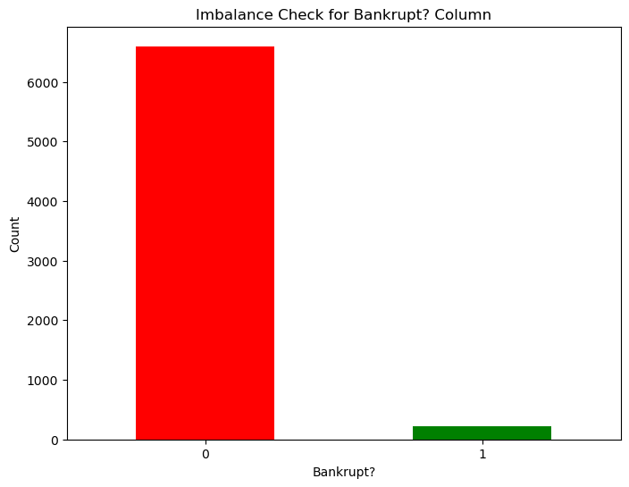
Deciphering the dataset
Imbalance in the dataset
Dataset Info
95
01
02
Features
Classes
Target Variable

Slide 5
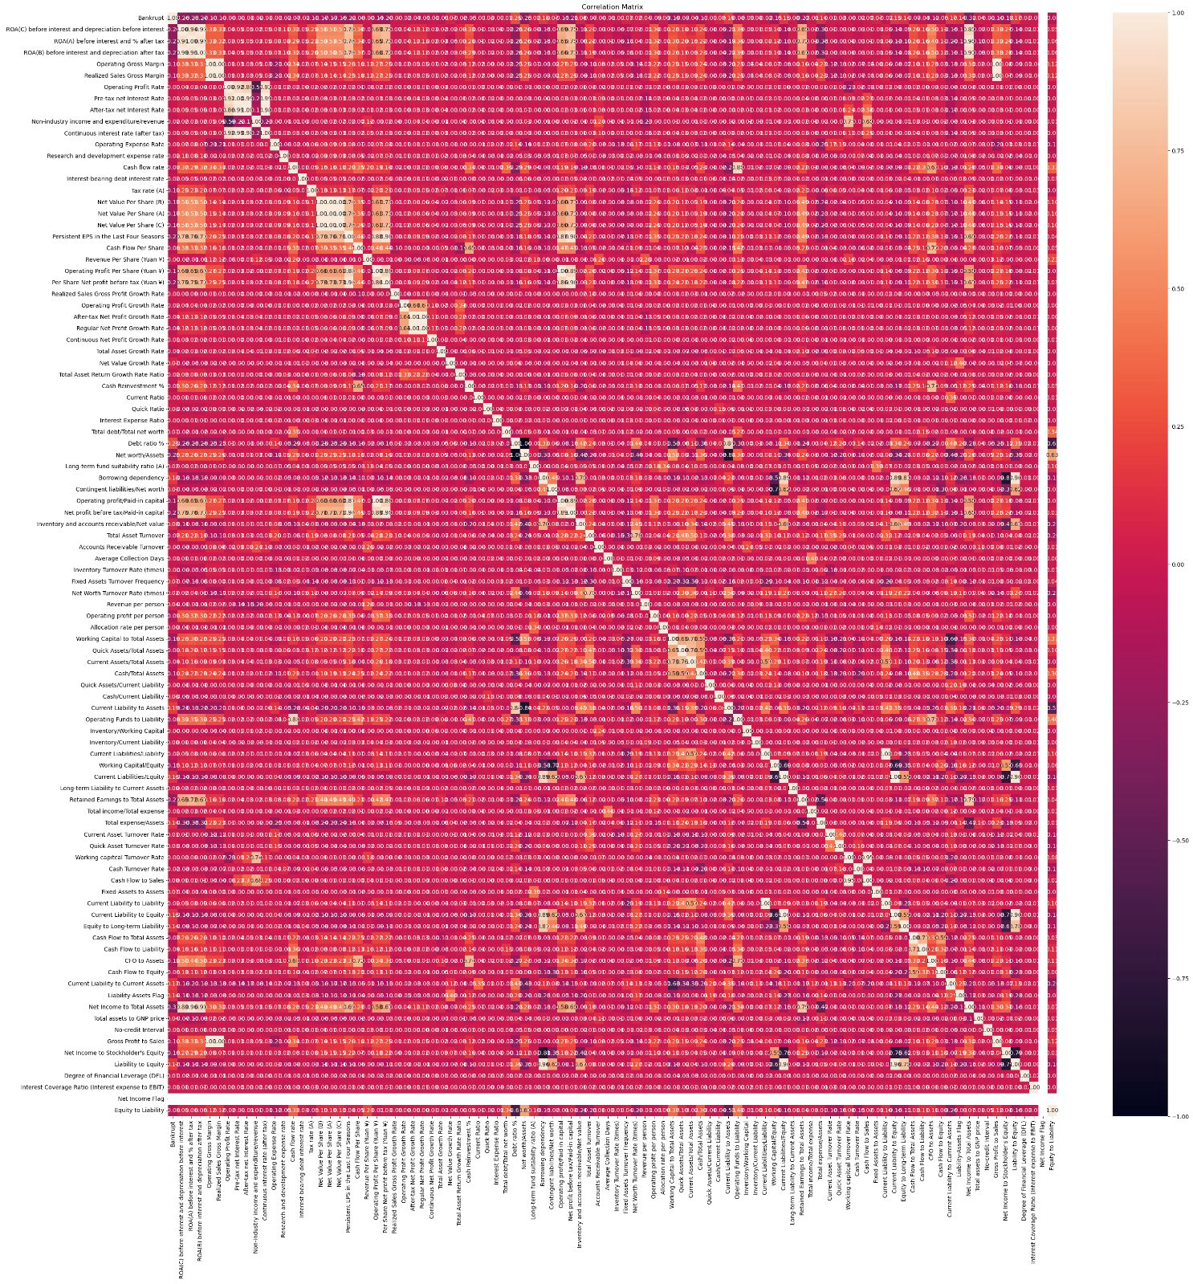
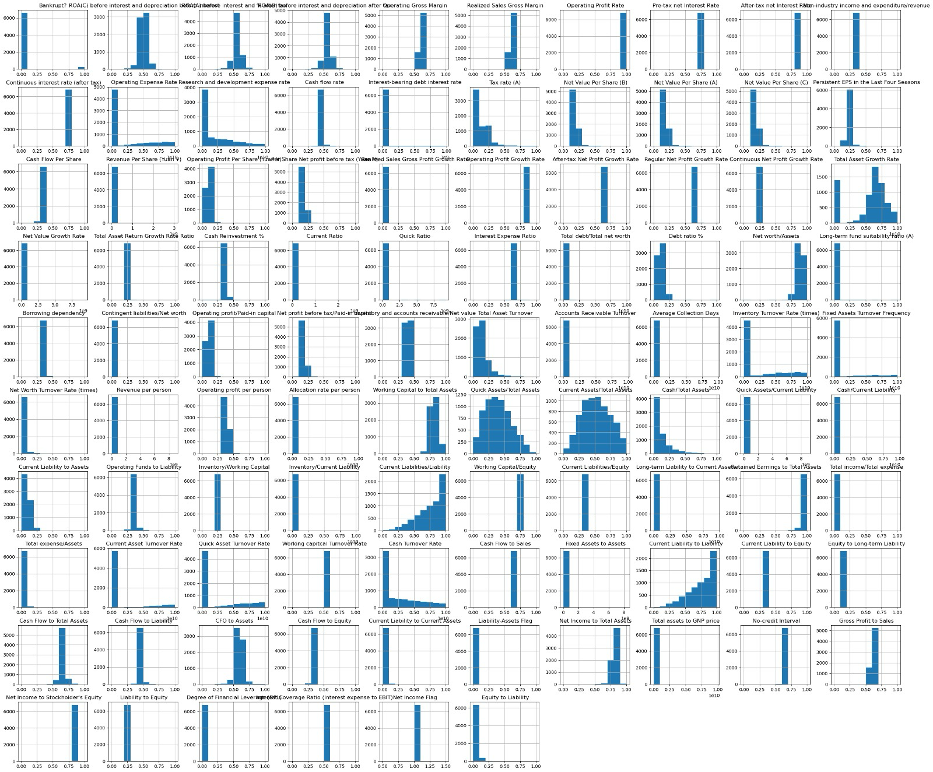

Slide 6
Role of PCA here!
Reduce Dimensions of dataset
Using this to overcome the lack of computational power

Slide 7
Implementation of Stability Selection
01
02
03
04
Sample the data
Apply a Feature Selection
Aggregate Results
Select Stable Features

Slide 8
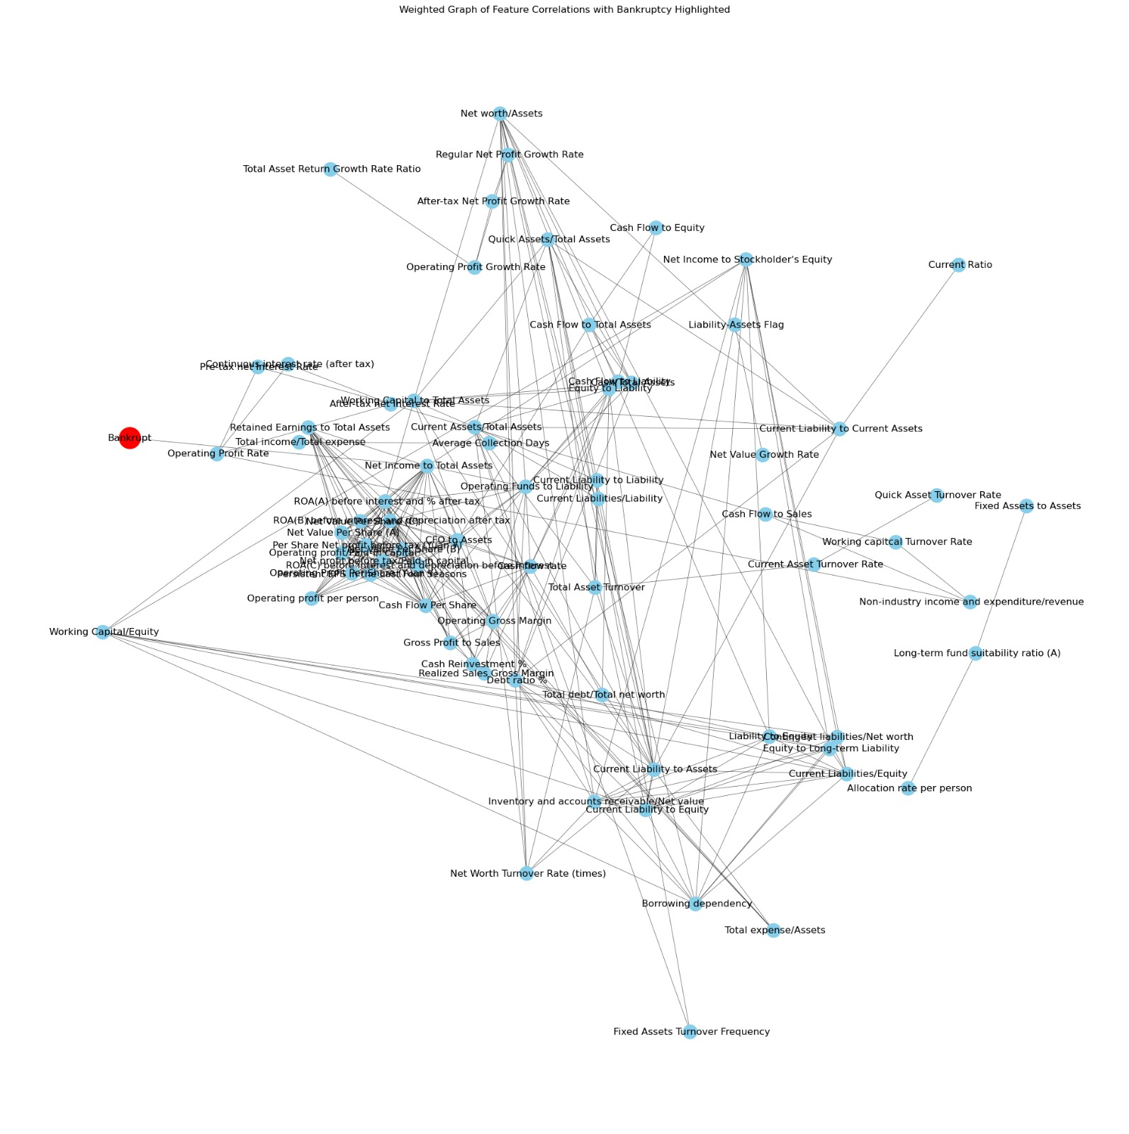
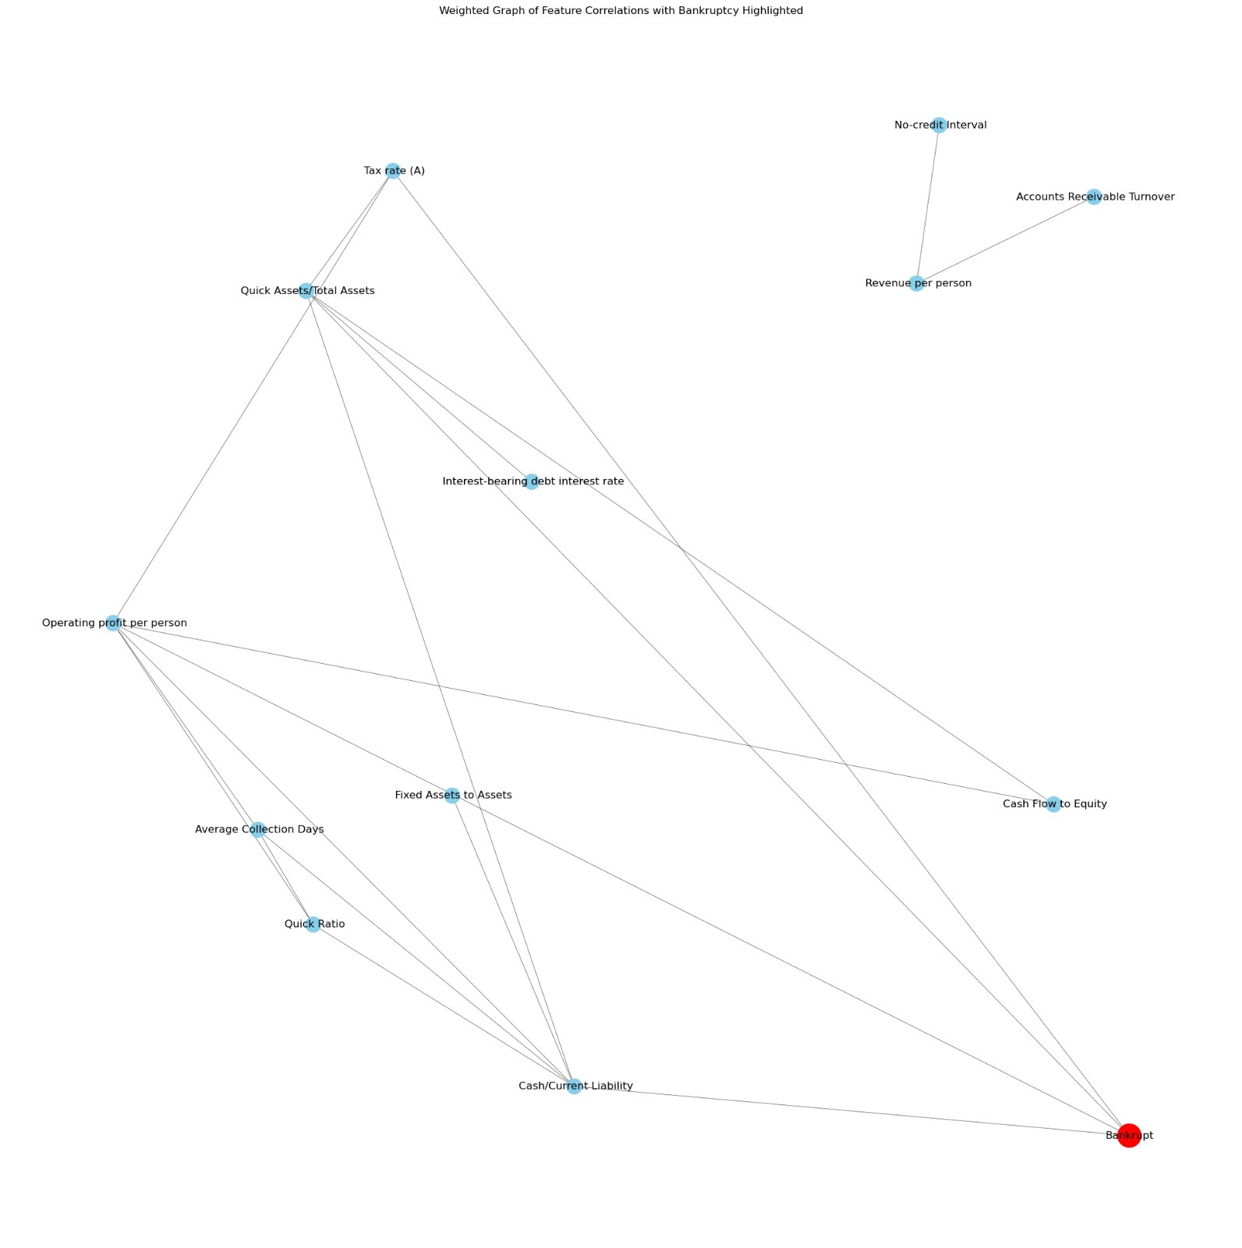
Initial Correlation Graph of Target Variable and Features
After PCA

Slide 9
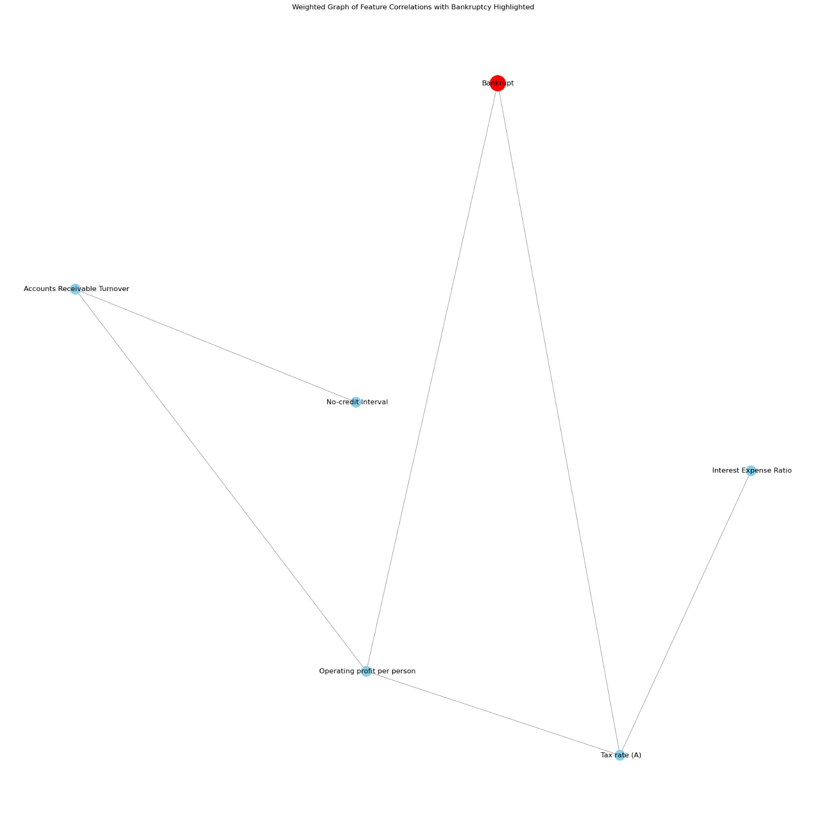
Final Output After Stability Selection

Slide 10
Models Implemented
Model | Accuracy | Precision | Recall | F1-Score
Logistic Regression (Baseline Model | 0.76 | 0.73 | 0.75 | 0.74
Logistic Regression (Grid Search CV) | 0.76 | 0.77 | 0.77 | 0.76
Random Forest Classifier | 0.795 | 0.79 | 0.79 | 0.8
Random Forest Classifier GridSearchCV | 0.818 | 0.82 | 0.81 | 0.82
Gradient Boosting Machines | 0.875 | 0.87 | 0.87 | 0.88

Slide 11
Thank You

